Slide 1
Clustering
Session 19-20

Slide 2
Learning Outcome
LO 1: Explain the fundamental of machine learning concept
LO 2: Interpret the distribution of dataset using regression method
LO 3: Experiment classification and clustering algorithm from given dataset

Slide 3
Outline
Clustering Analysis
Centroid Based Clustering
Density Based Clustering
Hierarchical Clustering

Slide 4
Clustering ANalysis

Slide 5
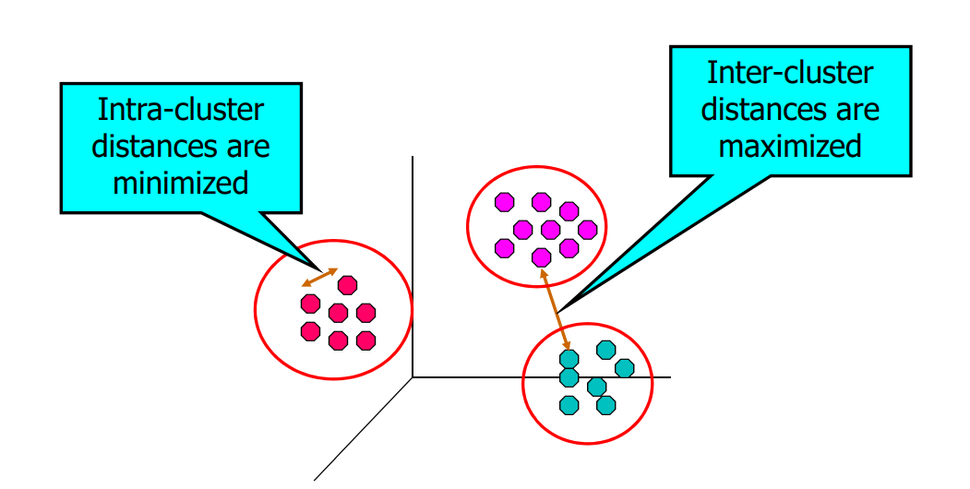
Clustering Analysis
Finding groups of objects such that the objects in a group will be similar (or related) to one another and different from (or unrelated to) the objects in other groups

Slide 6
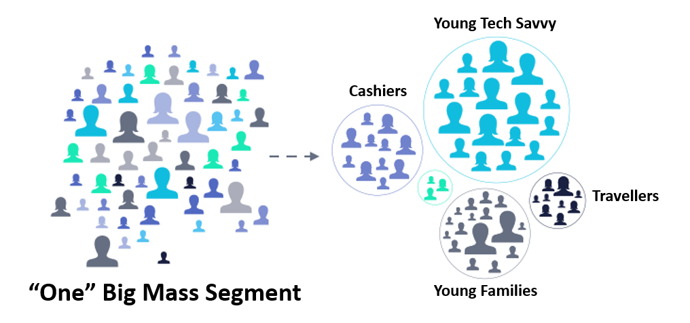
Clustering Analysis
Application of clustering analysis:
Customer Segmentation: Clustering is widely used in marketing to group customers based on their purchasing behavior, demographics, or preferences. This helps companies personalize their marketing strategies and target specific customer segments more effectively.

Slide 7
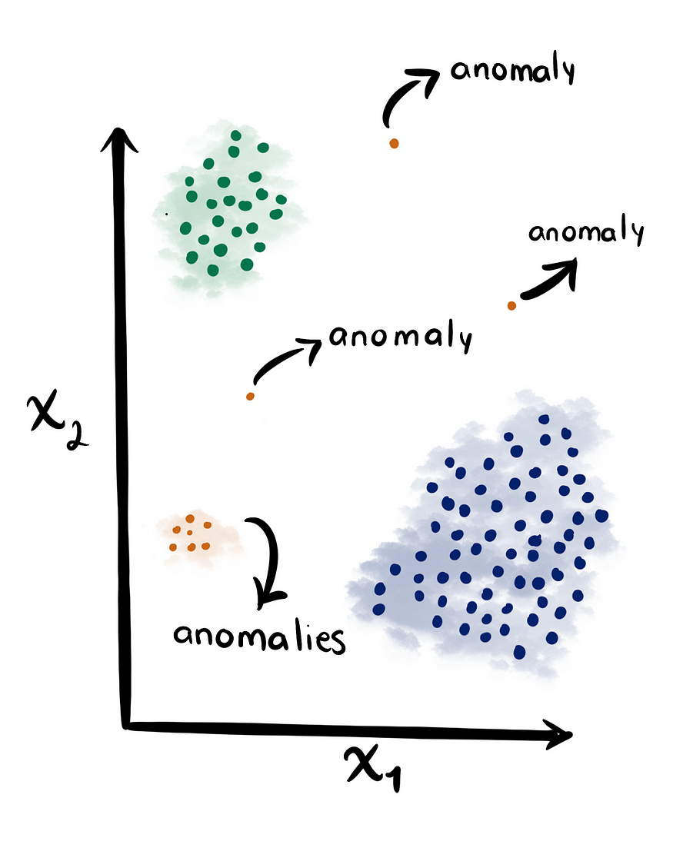
Clustering Analysis
Application of clustering analysis:
Anomaly Detection: Clustering techniques can be used to identify outliers or anomalies in datasets. This is applicable in fraud detection, network intrusion detection, identifying defective products in manufacturing, or monitoring system performance.

Slide 8
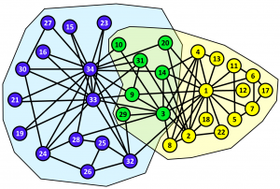
Clustering Analysis
Application of clustering analysis:
Social Network Analysis: Clustering algorithms can identify communities or groups within social networks based on user interactions or similarities. This helps in understanding network structures, influence analysis, targeted advertising, and recommendation systems.

Slide 9
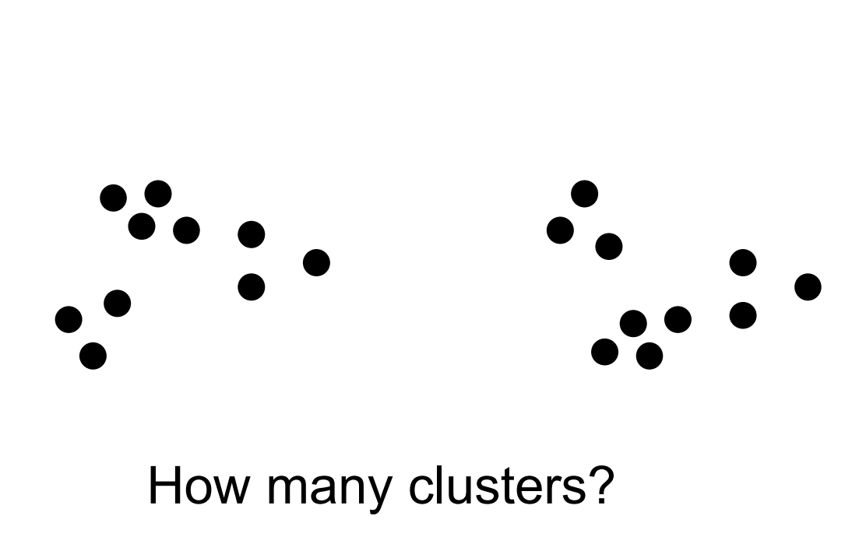
Clustering Analysis
Notion of a Cluster can be Ambiguous

Slide 10
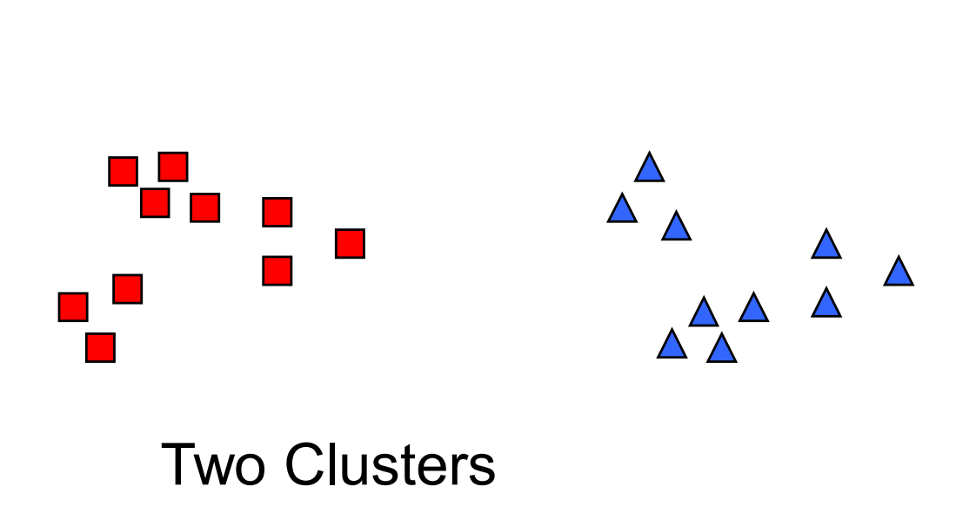
Clustering Analysis
Notion of a Cluster can be Ambiguous

Slide 11
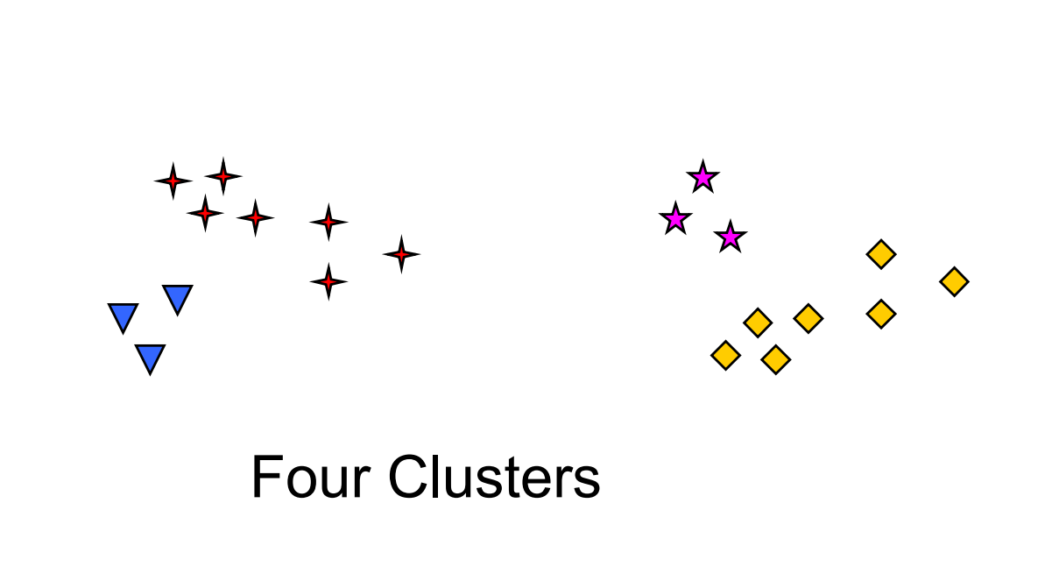
Clustering Analysis
Notion of a Cluster can be Ambiguous

Slide 12
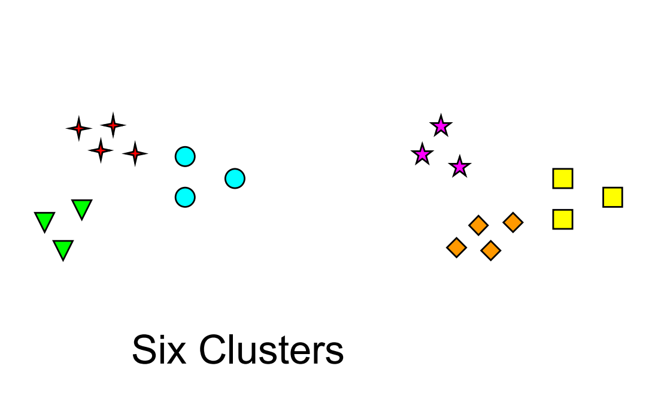
Clustering Analysis
Notion of a Cluster can be Ambiguous

Slide 13
Clustering Analysis
Type of Clustering:
Traditional Clustering algorithms:
Centroid based clustering algorithm
Hierarchy clustering
Fuzzy Theory based clustering
Distribution based clustering
Density based clustering
Graph theory based clustering
Grid based clustering
Fractal theory clustering
Model based clustering
Modern Clustering algorithms:
Kernel based clustering
Ensemble based clustering
Swarm Intelligence based clustering
Quantum based clustering
Affinity based clustering
Density and Distance based clustering
Data Stream based clustering
Deep Learning based clustering

Slide 14
Clustering Analysis
In this session we will focus on:
Centroid based clustering algorithm
Hierarchy clustering
Density based clustering

Slide 15
Centroid Based Clustering

Slide 16
Centroid Based Clustering
Centroid-based clustering is a machine learning technique that partitions a dataset into groups of similar data points, known as clusters. This technique uses centroids, the center of each cluster, to minimize the sum of the distances between the data points and their corresponding cluster centroids.
Centroid based clustering algorithms:
K-Means → This algorithm will be discussed in this session
K-Medoid

Slide 17
Centroid Based Clustering
K-Means
K-means clustering is one of the most used clustering algorithms
It was designed to cluster numerical data in which each cluster has a center called the mean.
In this algorithm, the number of clusters k is assumed to be fixed.

Slide 18
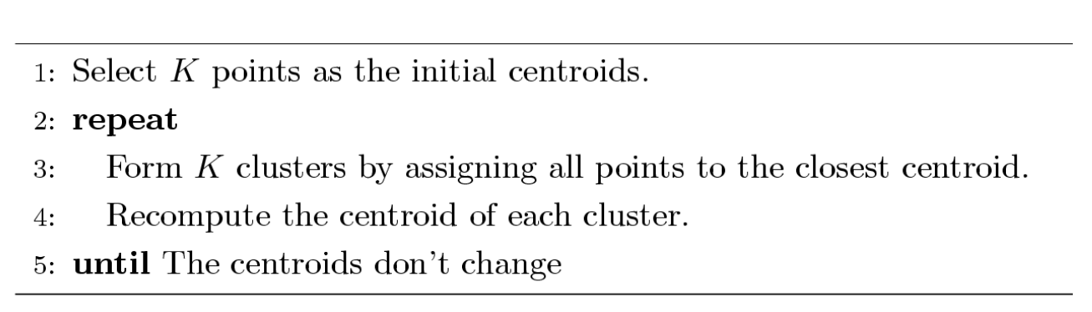
Centroid Based Clustering
K-Means
The Algorithm of K-Means Clustering:

Slide 19
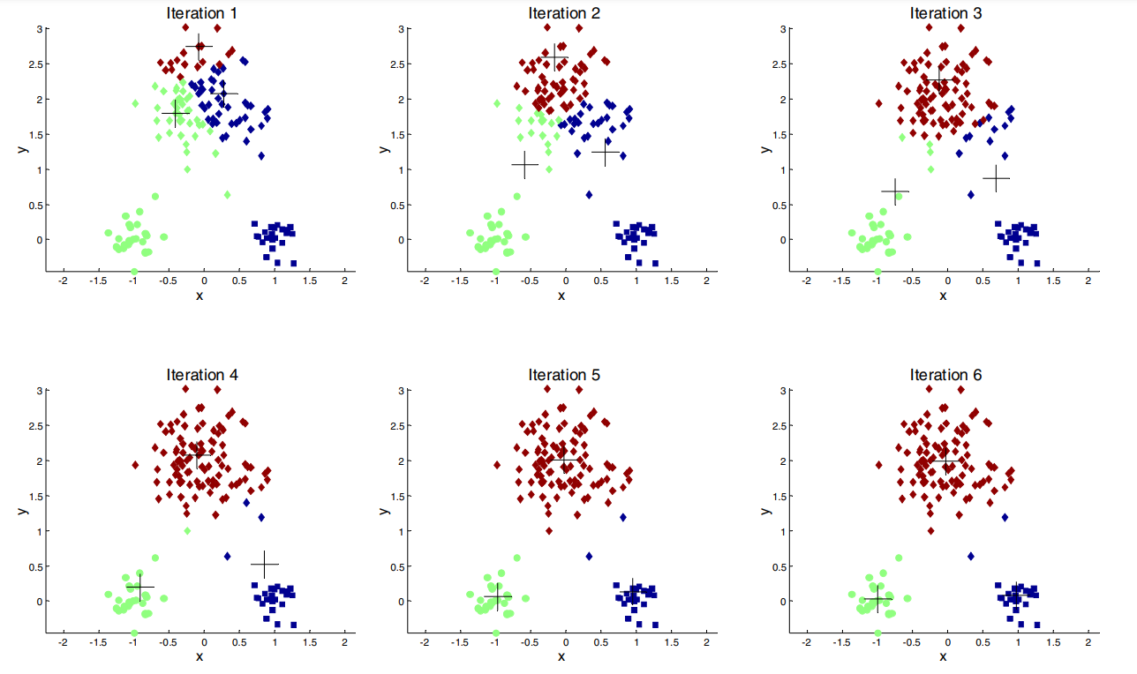
Centroid Based Clustering
K-Means

Slide 20
Centroid Based Clustering
How to Find optimal k?
There are two methods to find the optimal K in K-Means:
The Elbow Method
The Silhouette Method

Slide 21
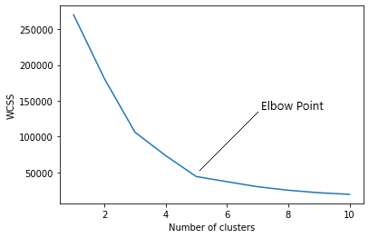
Centroid Based Clustering
The Elbow Method
The elbow method is a heuristic used in determining the number of clusters in a data
The elbow method runs k-means clustering (kmeans number of clusters) on the dataset for a range of values of k
We plot mean distance and look for the elbow point where the rate of decrease shifts.
Based on the picture, it can be determined that the optimal K of the elbow method is K = 5

Slide 22
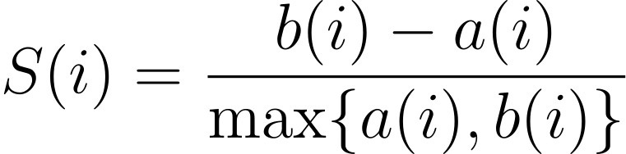
Centroid Based Clustering
Silhouette Method
The silhouette coefficient or silhouette score kmeans is a measure of how similar a data point is within-cluster (cohesion) compared to other clusters (separation).
The equation for calculating the silhouette coefﬁcient for a particular data point:
S(i) is the silhouette coefficient of the data point i.
a(i) is the average distance between i and all the other data points in the cluster to which i belongs.
b(i) is the average distance from i to all clusters to which i does not belong.
then calculate the average_silhouette for every k. and plot the graph between average_silhouette and K.

Slide 23
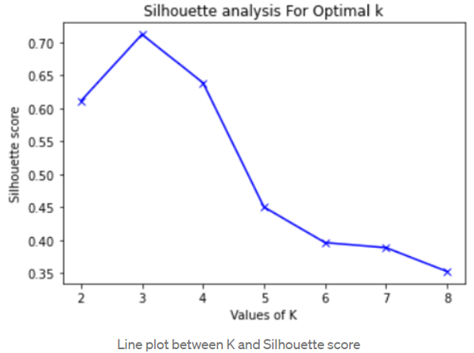
Centroid Based Clustering
Silhouette Method
We see that the silhouette score is maximized at k = 3. So, we will take 3 clusters.

Slide 24
Hierarchical Clustering

Slide 25
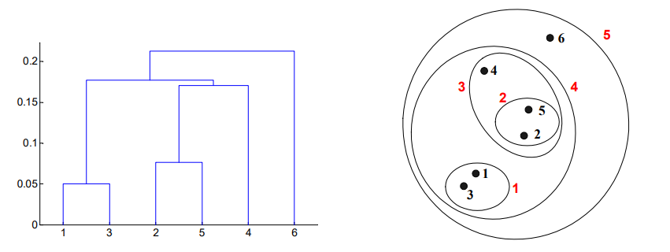
Hierarchical Clustering
Produces a set of nested clusters organized as a hierarchical tree
Can be visualized as a dendrogram
A tree like diagram that records the sequences of merges or splits

Slide 26
Hierarchical Clustering
Strengths of Hierarchical Clustering
Do not have to assume any particular number of clusters
Any desired number of clusters can be obtained by ‘cutting’ the dendogram at the proper level
They may correspond to meaningful taxonomies

Slide 27
Hierarchical Clustering
Two main types of hierarchical clustering
Agglomerative:
Start with the points as individual clusters
At each step, merge the closest pair of clusters until only one cluster (or k clusters) left
Divisive:
Start with one, all-inclusive cluster
At each step, split a cluster until each cluster contains a point (or there are k clusters)

Slide 28
Hierarchical Clustering
Agglomerative Hierarchical Clustering
More popular hierarchical clustering technique
Basic algorithm is straightforward
Compute the proximity matrix
Let each data point be a cluster
Repeat
Merge the two closest clusters
Update the proximity matrix
Until only a single cluster remains
Key operation is the computation of the proximity of two clusters:
Different approaches to defining the distance between clusters distinguish the different algorithms

Slide 29
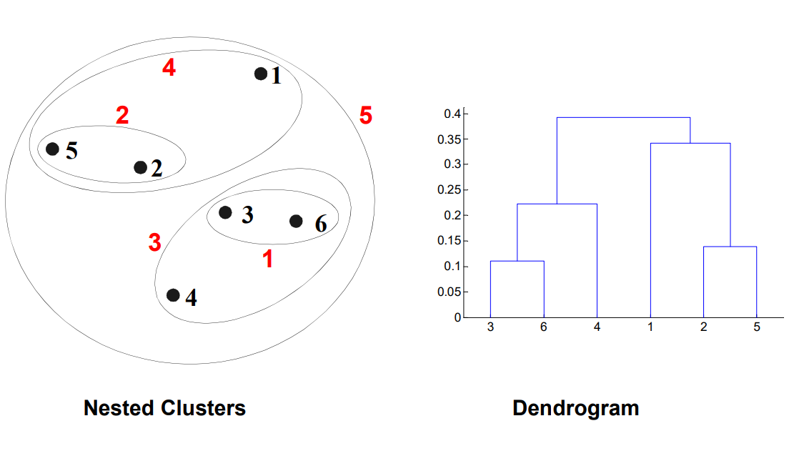
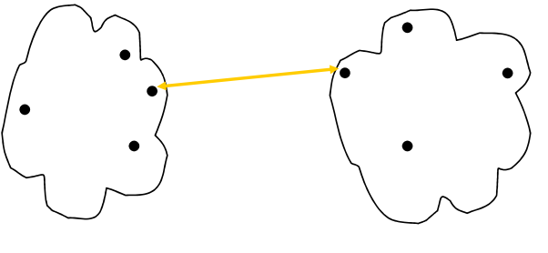
Hierarchical Clustering
How to define inter-cluster similarity
Cluster similarity: Min or Single Link
Similarity of two clusters is based on the two most similar (closest) points in the different clusters
Determined by one pair of points, i.e., by one link in the proximity graph.
Strength: Can handle non-elliptical shapes
Limitation: Sensitive to noise and outliers

Slide 30
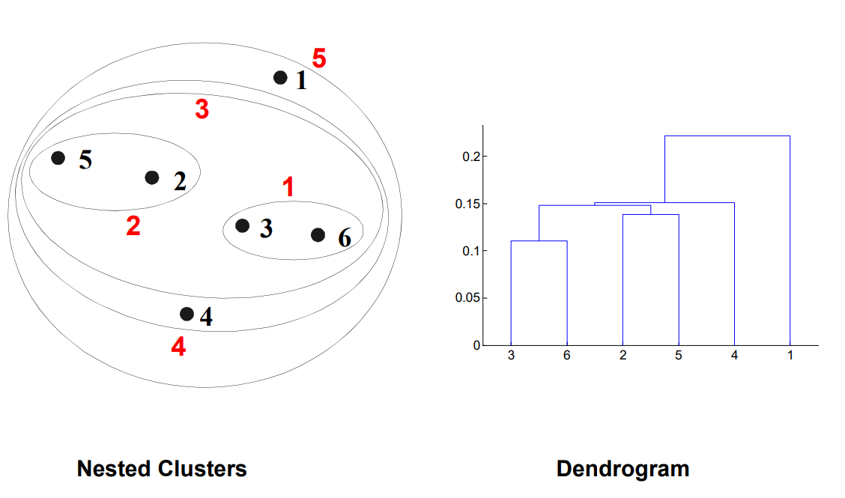
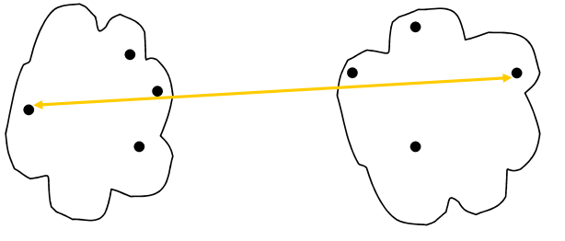
Hierarchical Clustering
How to define inter-cluster similarity
Cluster similarity: Max
Similarity of two clusters is based on the two least similar (most distant) points in the different clusters
Determined by all pairs of points in the two clusters
Strength: Less susceptible to noise and outliers
Limitation: Tends to break large clusters and Biased towards globular clusters

Slide 31
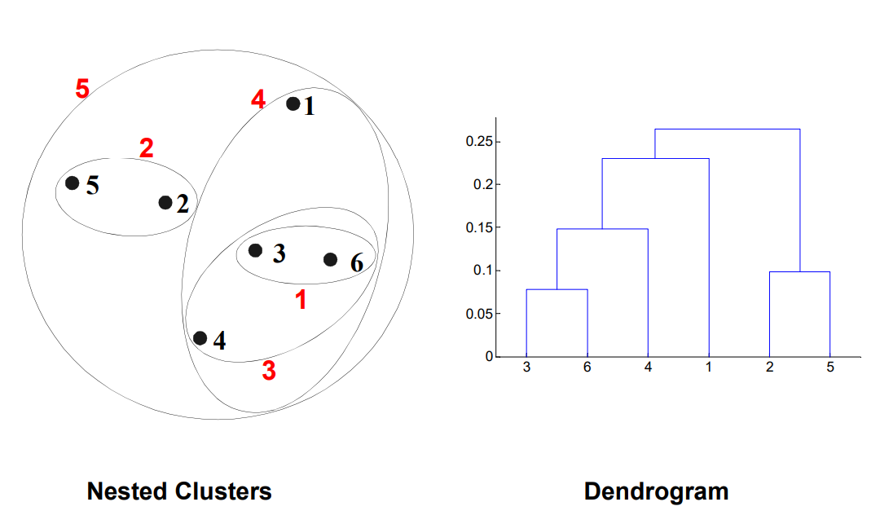
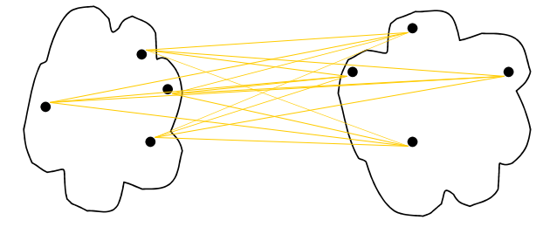
Hierarchical Clustering
How to define inter-cluster similarity
Cluster similarity: Group Average
Proximity of two clusters is the average of pairwise proximity between points in the two clusters
Need to use average connectivity for scalability since totalproximity favors large clusters
Strength: Less susceptible to noise and outliers
Limitation: Biased towards globular clusters

Slide 32
Density Based Clustering

Slide 33
Density Based Clustering
DBSCAN is a density-based algorithm
Density = number of points within a specified radius (Eps)
A point is a core point if it has more than a specified number of points (MinPts) within Eps
These are points that are at the interior of a cluster
A border point has fewer than MinPts within Eps, but is in the neighborhood of a core point
A noise point is any point that is not a core point or a border point.

Slide 34
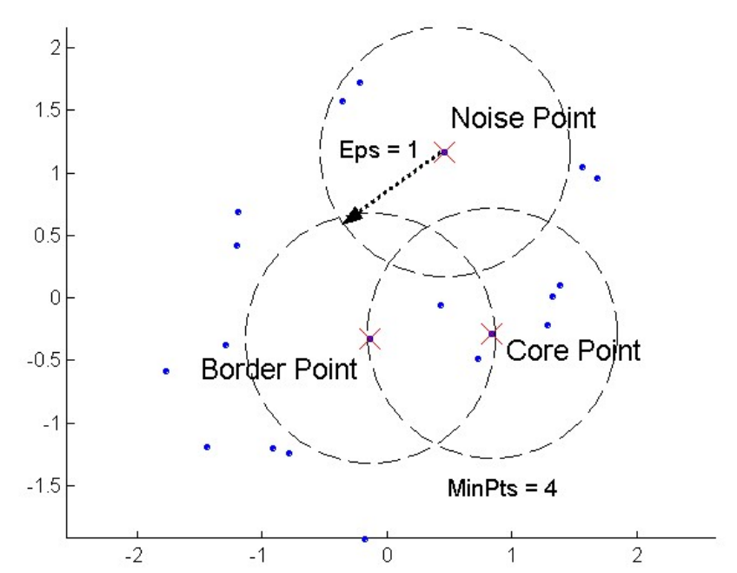
Density Based Clustering
DBSCAN: Core, Border, and Noise Points

Slide 35
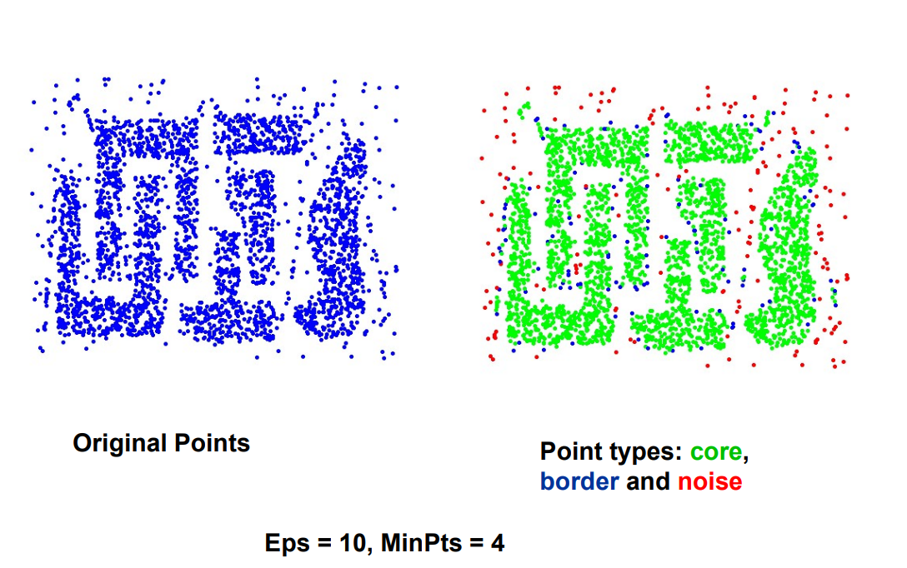
Density Based Clustering
DBSCAN: Core, Border, and Noise Points

Slide 36
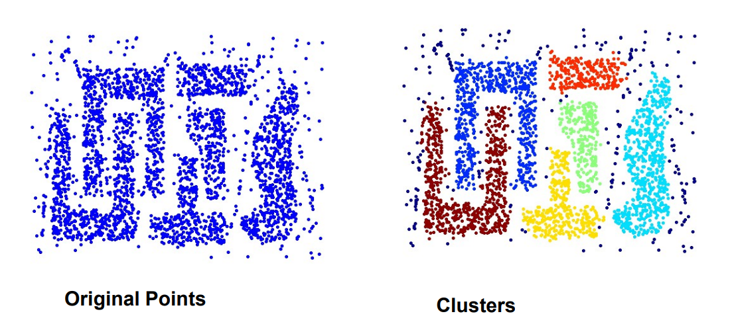
Density Based Clustering
DBSCAN: Core, Border, and Noise Points
Strength DBScan:
Resistant to Noise
Can handle clusters of different shapes and sizes

Slide 37
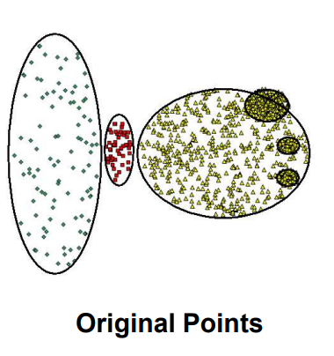
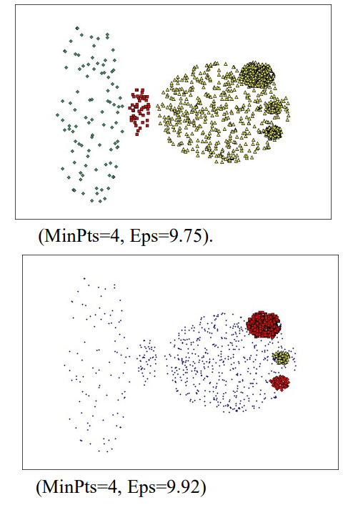
Density Based Clustering
DBSCAN: Core, Border, and Noise Points
When DBScan is not work well:
Varying densities
High-dimensional data

Slide 38
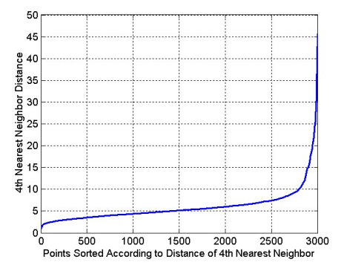
Density Based Clustering
DBSCAN: Determining EPS and MinPts
Idea is that for points in a cluster, their kth nearest neighbors are at roughly the same distance
Noise points have the kth nearest neighbor at farther distance
So, plot sorted distance of every point to its kth nearest neighbor

Slide 39
Exercise

Slide 40
Exercise
You are a data scientist assigned to work on an ecological study about penguins. Your task is to develop a clustering model to categorize penguin species based on various physical characteristics and measurements (https://www.kaggle.com/datasets/youssefaboelwafa/clustering-penguins-species) . The dataset includes attributes like bill length, bill depth, flipper length, body mass, and perhaps other ecological data.
Train your clustering model on the dataset.
Analyze the clusters formed. Assess how well the clusters correspond to the different species of penguins and interpret the clustering results.

Slide 41
References

Slide 42
References
Arroyo, I. (2022, February). Unsupervised Anomaly detection on Spotify data: K-Means vs Local Outlier Factor. Medium. https://towardsdatascience.com/unsupervised-anomaly-detection-on-spotify-data-k-means-vs-local-outlier-factor-f96ae783d7a7
Banerji, A. (2023). K-Mean: Getting the Optimal Number of Clusters. Analytics Vidhya. https://www.analyticsvidhya.com/blog/2021/05/k-mean-getting-the-optimal-number-of-clusters/
James, G., Witten, D., Hastie, T., Tibshirani, R., & Taylor, J. E. (2023). An introduction to statistical learning: With applications in Python. Springer.
Saji, B. (2023). Elbow Method for Finding the Optimal Number of Clusters in K-Means. Analytics Vidhya. https://www.analyticsvidhya.com/blog/2021/01/in-depth-intuition-of-k-means-clustering-algorithm-in-machine-learning/
Tan, P.-N., Steinbach, M., Karpatne, A., & Kumar, V. (2019). Introduction to data mining (Second edition). Pearson.
Whang, J., & Dhillon, I. (2016). Overlapping Community Detection in Massive Social Networks. Center for Big Data Analytics. https://bigdata.oden.utexas.edu/project/graph-clustering/
Xu, D., & Tian, Y. (2015). A Comprehensive Survey of Clustering Algorithms. Annals of Data Science, 2(2), 165–193. https://doi.org/10.1007/s40745-015-0040-1

